Slide 1
Advanced C++ Internals: Chapter 6 C++ Strings
ZACOCPPINT

Slide 2
Learning Journey:
Need a drink?
<cstring>
C-string memory layout C-string memory view (executable)
<string>
string Benefits
string Instantiation Variances
Raw String Literals
Small string optimization (SSO)
gcc string
string_view
string_view usage
std::format for string construction
Lab #6
Strings from a coding perspective
Lab #7
Strings from a reverse engineering perspective
Summary
Appendices:
Useful links
Learning Outcomes:
Must be able to identify elements of a sample string memory layout
Should be able to differentiate between different types of string
Could be able to identify strings in memory and their compiler implementation
C++ Strings

Slide 3

#include <string>
#include <string_view>
class Drink {
public:
Drink(const char* name, int volume) : _name(name), _volume(volume) {}
// queries
std::string_view name() const { return _name; }
int amount_left() const { return _volume; }
// modifiers
bool take_sip(int sip);
private:
std::string _name;
int _volume;
};
Need a Drink?
Notes:
This slide introduces some features to be explored in the following slides.
In this chapter we focus on strings.
Class details will be covered later.

Slide 4
Drink(const char* name, int volume)
<cstring>
char[], char*, const char*
common for literals and non-owning string arguments
<cstring> for strncpy, strncat, strncmp, strlen etc.
no built-in heap management.
#include <iostream>
const char* hello() { return "Hello"; }
int main() {
const char* world = " world";
std::cout << hello() << world << std::endl;
}
Notes:
The <cstring> header file is part of the C++ standard library, analogous to C’s (hopefully familiar) <string.h>
It contains support for string manipulation, memory manipulation, error numbers/messages and constants.
c-strings are still commonly used for function arguments
- No out-of-range protection
- string_view is a modern and safer replacement.
Further reading:
https://cplusplus.com/reference/cstring/

Slide 5


char * | Pointer to contiguous memory | 0 | 1 | 2 | 3 | 4 | 5
char * | Pointer to contiguous memory | ? | ? | ? | ? | ? | ?
C-string Memory Layout
Example null-terminated string (ASCIIZ):
world -> | 0 | 1 | 2 | 3 | 4 | 5
char * | w | o | r | l | d | \0
Poor choice as a data-member!
requires explicit memory management
no bounds protection so…
modifying a char* string often leads to buffer overflows
Notes:
Key Characteristics of ASCIIZ Strings:
Although the term “string” is used here, let’s be honest these are really character arrays. But rather than accessing individual characters, certain functions can process them as strings if they are suitably terminated.
Some basic facts:
Uses ASCII (American Standard Code for Information Interchange) Characters:
A string contains characters encoded in the ASCII character set, where each character is represented by a single byte.
Each character has a unique corresponding value in the ASCII table (e.g., 'A' is 65, 'a' is 97 etc.)
How they are stored in Memory:
As with any other array, the string is stored in contiguous memory, and the length of the string is not explicitly stored (see Null-Terminated below)
Contemporaneous storage solutions for solutions for strings used the leading byte for this, often leading to maximum string lengths of 255 characters (max unsigned 8 bit integer, of course)
They are Null-Terminated:
The end of the string is physically marked by the special escape character '\0' (the null character); this has an ASCII value of 0 (Zero).
This null character marks the end of the string, permitting string-processing functions, e.g. strlen() to know when the string ends.

Slide 6
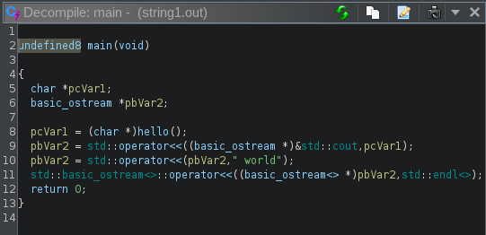
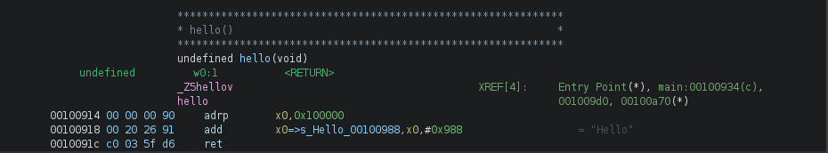
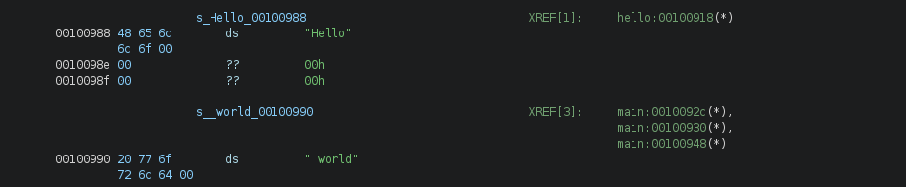
Here are the C-strings stored and accessed from their locations in the non-optimised executable:
C-string Memory View (executable)
Notes:
Here you can see the C-strings being referenced directly or via their function call.
Note the simple ASCII-style byte-based encoding and the NULL terminators on each literal.

Slide 7
private:
std::string _name;
<string>
string | is: | capacity | size | Body-pointer
Example:
String object is usually on the stack.
Its body is usually on the heap.
Can convert to const char * C-string using c_str() when needed for legacy code
msg | is: | 100 | 50 | body*
body* | points to: | heap | [message]
Notes:
The <string> header provides the declaration for the C++ Standard Library “string” class, i.e. std::string and its related functions. It’s actually part of the STL (Standard Template Library) and was introduced as an improvement over classic C-strings.
"usually on the stack"
All non-static objects declared in function-scope live on the stack
An object (such as a string) may have a heap-allocated body
A heap-allocated body, may itself contain objects (e.g. a vector of strings)
Those heap objects do not have any component on the stack. Thus, we may have c-strings and arrays etc. that are normally considered stack-based objects, which live entirely on the heap
Further reading
https://cplusplus.com/reference/string/

Slide 8
copy, assign, append (+)
many member functions
basic_string <char>
wrapper for a c-string on the heap.
.at(index) does bounds-check (std::out_of_range exception thrown)
Operations may result in multiple allocations (and deallocations):
This results in:
Multiple memory dynamic allocations for each + operation
Multiple copying and memory movement operations
Degraded performance
string Benefits
auto bigStr = strA + strB + strC; // multiple temporaries!
Notes:
"many member functions"
std::string is a templated type (actually a typedef for a templated type)
templated types are automatically inlined
therefore only those functions that are used by the client are included in the executable.
“multiple temporaries"
Not usually a performance problem
std::accumulate often used for efficient vector<string> concatenation
Some sources may recommend use of std::ostringstream, e.g.
std::ostringstream oss;
oss << strA << strB << strC;
std::string bigStr = oss.str();
Which streams the data into the buffer avoiding the creation of multiple string objects created during + operations.

Slide 9
Other C++ string types include:
std::wstring
std::u16string
std::u32string
string Instantiation Variances
include <string>
std::wstring greetString = L"Welcome!";
include <string>
std::u16string utf16Greet = u"Welcome!";
std::u32string utf32Greet = U"Welcome!";
Notes:
L is an unspecified wide character encoding (not necessarily ASCII or Unicode).
std::u8string and u8"Hello" built on char8_t and indicates utf8 encoding.
Likewise, std::u16string and u"Hello" built on char16_t and indicates utf16 encoding.
and std::u32string and U"Hello" built on char32_t and indicates utf32 encoding.
wstring is a wide character string for Windows (UTF-16) and Linux/Unix (UTF-32); very similar otherwise to std::string, but essentially provides support for text requiring more than 8 bits per characters for non-English alphabets, emojis etc.
Note the different “u” and “U” as string prefixes in each case, somewhat analogous to Python 3’s support.
Further reading
https://cplusplus.com/reference/string/

Slide 10
Also added in C++11 was the ability to store raw literals.
These are literals which do no not escape any character
anything between the ( and ) delimiters are used verbatim.
Use the “R” prefix and ( ) delimiters like so:
It’s particularly useful when creating:
“old school” Windows pathnames, e.g. “c:\test”
Regular Expressions
Raw String Literals
// Regular string literal
std::cout << "c:\newfile.txt\n";
// Raw string literal
std::cout << R"(c:\newfile.txt\n)";
11
c:
ewfile.txt
c:\newfile.txt\n
Notes:
Essentially, there’s no need to worry about “double” escaping.
All the above string literal-types may be raw. 'R' comes after the type-prefix:
u8R"(Hello)";
A pattern of up to 16 characters (excluding ()\<space>) may be inserted between the " and brackets to make up the raw-delimiter.

Slide 11
Avoids heap allocation for short strings
Stores within the string object itself
15-23 chars (depending on implementation and architecture)depending on compiler
Small String Optimization (SSO)
string(clang) | == | capacity | size | body
24-bytes | == | 8-bytes | 8-bytes | 8-bytes
longStr | == | cap&1 | size | heapAddr
shortStr | == | size&0 | 23-byte string
Notes:
Strings are implemented as a specialized vector of chars.
The compiler provides a capacity that typically exceeds the string length to allow for some growth.
Further growth will trigger a reallocation with more capacity.
A string therefore requires a capacity, size and body-pointer.
Compiler-vendors can implement strings as they wish. clang, gcc and msvc all take different approaches.
There are also non-std offerings with better SSO performance.

Slide 12
gcc string
string (gcc) | == | body | Size | capacity
32-bytes | == | 8-bytes | 8-bytes | 16-bytes
longStr | == | heapAddr | size | capacity
shortStr | == | this | <=15 | 15-byte string

Slide 13
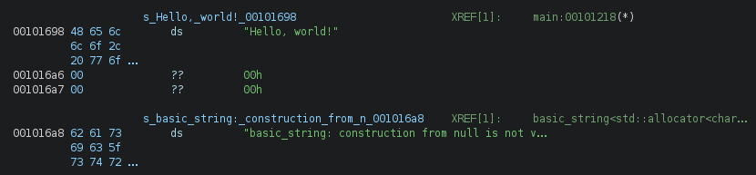
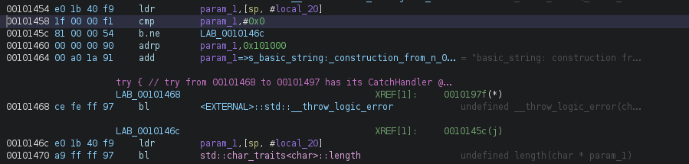
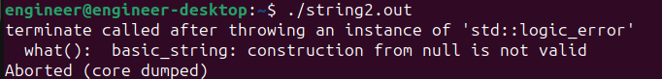
As discussed, a gcc string must be allocated somewhere, depending on size (internal buffer of the std::string object, if SSO or heap if larger).
Regardless, null references are not allowed for initialisation
an empty string is fine.
std::string Memory View
Notes:
Shown here are the string literals for our text and the error message raised by a null initialisation, and the associated protective guard statement in the assembly language referencing it.
If we attempt to initialize the string with a null reference, the “try” block will raise the appropriate error (and message) and terminate the process.

Slide 14
string_view
a pointer and a length
read-only reference to [part of] a c-string
you can refer to a string without copying it*
that c-string may be the body of a std::string
fast, light-weight
enjoys full support for constrexpr – unlike std::string
provides all std::string query functions
use .at(index) for bounds-checking
17
Notes:
string_view was introduced in C++17; particularly useful when working with substrings or portions of strings without the need for memory allocation or initializing/copying (as with std::string).
* Technical note
Being C++, it is possible to shoot yourself in the foot by letting the original string go out of scope during the lifetime of a string_view object – would be similar to a dangling pointer in C, with potentially unexpected behaviour.
#include <iostream>
#include <string>
#include <string_view>
std::string_view createStringView() {
std::string tempString = "Hello, World!";
std::string_view view = tempString; // Pointing to the temporary string
return view; // Returning the string_view referencing the temporary string
}
int main() {
std::string_view view = createStringView(); // The temporary string has gone out of scope
// Attempting to access the view after the original string is destroyed (this will compile, but may or may not work correctly…)
std::cout << "String view content: " << view << std::endl;
return 0;
}

Slide 15
#include <string_view>
auto world_view = string_view{ "Window on the World" };
auto lastWord = world_view.substr(world_view.find_last_of(' '));
string_view Usage
17
Alternative to const C-strings
Alternative to const string& for function parameters
Better than returning string copies of object data
Use whenever const substrings are required
Changing the text assigned to the string_view doesn’t modify the prior assigned string.
Use no, s, or sv suffices to differentiate double-quoted literals
string-view | == | char* | Size
16 bytes |  | uintptr_t | size_t
Notes:
They are quite flexible to use and can be initialised by:
C-string literal
std::string
Another string_view
However, if used as a function parameter, a std::string_view will implicitly convert C-string and std::string argument.
But (and this is worth noting): a std::string_view will not implicitly convert to std::string, if trying to pass a std::string_view argument to a std::string parameter.
Why? To prevent the relatively expensive copy of its initializer – which defeats the intended efficiencywhat uis. There are ways around it, if you really must…

Slide 16
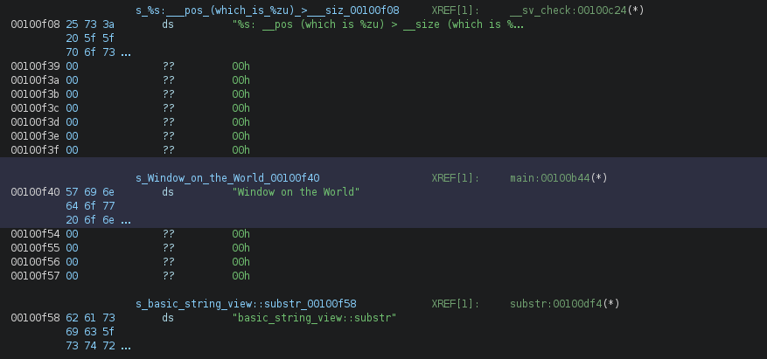
Here’s the initial storage of the C-String literal which will be used to initialise the string_view instance at run-time.
Note the additional strings for the substr guard check.
string_viewMemory View

Slide 17
#include <format>
msg = std::format("written {0:0>3} lines of code", _code_written);
std::format for String Construction
20
Returns a string
Easier than stringstream class from <sstream>
No interpolation (e.g. variable embedding) - yet!
Formatting as in Python and like C’s printf
Using {argIndex:format} placeholder
Both parts optional
Notes:
As noted, this feature was introduced in C++20; previous “fmt”-style libraries do exist which offer similar functionality, but are not in the published C++ standard.
The way to go for modern string formatting (Hmm! looks like C-string formatting to me!)
As of December 2023, not yet supported on Raspberry Pi (gcc 12)!
As noted, full string interpolation is the missing element here, as that’s available (and widely-used) in popular languages such as Python (with f-strings) and C#.
Here’s a larger example showing the “argIndex” and “format” parts of the std::format’s placeholder being absent (- so it’s working positionally):
#include <iostream>
#include <format>
int main() {
std::string service = "HTTP";
int port = 80;
// syntax without the optional argIndex and format
auto interpolated = std::format("Service {} on port {} is identified.", service, port);
std::cout << interpolated << std::endl;
return 0;
}
And here’s the expected output:
Service HTTP on port 80 is identified.
Technical note.
If used, the argIndex will override the arguments’ positional order.

Slide 18
C++ Internals Lab #6
Strings (coding perspective)
Notes:
This lab focuses on using strings from a coding perspective

Slide 19
C++ Internals Lab #7
Strings (reverse engineering perspective)
Notes:
This lab focuses on strings – from a reverse engineering perspective

Slide 20
C++ code supports different types of strings
C-strings; essentially an ASCIIZ static array of characters
std::string – dynamic array of characters
Probably the most common technique in modern C++
std::string_ view
std::format
Not fully implemented yet, compared to other languages
std::wstring – wide character strings (wchar-t)
Typically UTF-16 on Windows
Typically UTF-32 on Linux/Unix
std::u16string and std::u32string
Unicode, cross-platform support
Applications could theoretically use just one or any combination of these string types.
String storage in memory (their layout etc.) may be compiler dependent, i.e. it’s an implementation issue
Being able to locate strings and understand how they may have been created is an important skill.
Summary

Slide 21
Any questions?

Slide 22
Appendices
Notes:
Some additional information you may find useful…

Slide 23
Websites and online resources
GCC, the GNU Compiler Collection (no date) GCC, the GNU Compiler Collection - GNU Project. Available at: https://gcc.gnu.org/ (Accessed: 16 November 2023).
Clang 18.0.0git documentation (no date) Clang Compiler User’s Manual - Clang 18.0.0git documentation. Available at: https://clang.llvm.org/docs/UsersManual.html (Accessed: 18 December 2023).
C++ Standard Library (no date) cppreference.com. Available at: https://en.cppreference.com/w/cpp/standard_library (Accessed: 16 November 2023).
JTC1/SC22/WG21 - The C++ Standards Committee - ISOCPP (no date) . Available at: https://www.open-std.org/jtc1/sc22/wg21/ (Accessed: 16 November 2023).
Useful resources

Slide 24
Review of Chapter’s Learning Outcomes

Slide 25
Learning Outcomes:
By the completion of this chapter, you…
Must be able to identify elements of a sample string memory layout
Should be able to differentiate between different types of string
Could be able to identify strings in memory and their compiler implementation
Please review these learning outcomes at chapter's end.
Learning Outcomes

